Slide 1
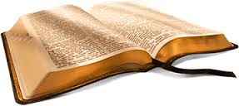
BIBLE READING
ORIENTATION FOR TALENT SEARCH

Slide 2
CRITERIA
Introduction
Locating the correct portion, repeating the portion and starting of reading within 1minute
Accuracy, Clarity and Continuity
Style of Reading
Posture
Conclusion

Slide 3
STEP BY STEP – GUIDELINES TO FOLLOW
Pick the chit from the bowl, open and show it to the person in charge.
Take the chit and go to the podium
Read out the portion to the audience (clearly and loudly )

Slide 4
STEP BY STEP – GUIDELINES TO FOLLOW
Read out the portion to the audience (clearly and loudly )
Eg : The Scripture portion is taken from
1 Corin: 13: 11-13
The Bible/ The Scripture portion is taken from The First epistle of Paul the Apostle to the Corinthians chapter thirteen verses eleven to thirteen.
Then Open the Bible &Take the portion and then repeat
First Corinthians chapter 13 verses eleven to thirteen (1 Cor. 13:11-13)

Slide 5

SPECIFY THE BOOK WITH AUTHOR
From Genesis to Job: The book of _____ , Repeat: Genesis/ Job
From Isaiah to Malachi: The book of Prophet Isaiah -, Repeat: Isaiah/ Malachi
Lamentations: The book of Lamentations….
Gospels: The gospel according to Saint Mathew/Mark/Luke/John, Repeat: Mathew /John
Acts: The Acts of the Apostles..... Repeat: Acts
Romans to Philemon: The Epistle of Paul the Apostle to the Romans/ Philemon, Repeat: Romans/ Philemon
Hebrews: The epistle to the Hebrews, Repeat: Hebrews
James to Jude: The epistle of James, The first/ second epistle of Peter, The first/second/third epistle of John, The epistle of Jude, Repeat: James/ John
Revelation: The book of Revelation …Repeat: Revelation

Slide 6
STEP BY STEP – GUIDELINES TO FOLLOW
Bible will be kept on the podium. (If no podium is available take and hold the Bible in hands; use both hands to hold the Bible.) . Remember handle the Bible with reverence and respect.
Open the Bible “close to the portion” given from the Old Testament (OT) or the New Testament (NT).
Remember:
Always open bible with the lengthwise facing you.
Do not refer the contents/ index written at the beginning of Bible with page nos. in it.
Also after opening the Bible, Make sure that you are going to the right direction for turning the pages ( eg. If OT Book, towards your left, if NT vice versa…)

Slide 7
STEP BY STEP – GUIDELINES TO FOLLOW
Read out the Bible portion again., this time you should say eg: First Corinthians : Chapter “13” : Verses: “1-3”
1. While Reading the portion
Read the portion clearly and audibly
Maintain eye contact with the audience, where it is appropriate to do, if you can (meaning to say, if it’s so difficult for you, instead of making mistake, it’s better not to do.)
Pause at the punctuations and at the full stop.
2. After completing the lesson reading
Say: Here ends the lesson
OR
If Old/New Testament Books: - This is the Word of the Lord.
Gospel Books: - This is the Word of the Lord Jesus

Slide 8
STEP BY STEP – GUIDELINES TO FOLLOW
Close the Bible from front to back – (Always place the Bible with the cover facing you).
Return the chit to the person in charge & back to your seat.

Slide 9
REMEMBER THIS – BE VIGILANT
Books with one chapter only: Old Testament: Obadiah, New Testament: Philemon, 2nd John(epistle), 3rd John (epistle), Jude.
Chapter should not be mentioned, Verses from to only.
Example: The epistle of Jude verses three to five, repeat: Jude verses 3 to 5.

Slide 10
AVOID
LOOKING AT THE INDEX PAGE
SWINGING OF BODY, LEANING TO SIDES
OPENING THE BIBLE FROM THE WRONG SIDE
MENTIONING CHAPTER OF BOOKS WITH ONE CHAPTER ONLY

Slide 11
Friends.. all the very best …
Please make / maintain the habit of Bible reading
Please participate...
The main objective is to make you proud to stand with The Word of God and you are standing before God... That's all..
No matter the end result.. Our “Immanuel” which means “God with us” with you.

Slide 12
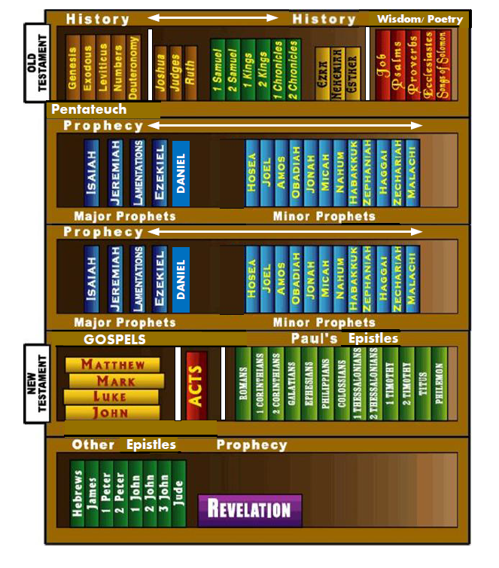

Slide 13

ANY QUESTIONS

